Slide 1

Sym✓
Fall 2020 Capstone project | Professor Henry Wong
Alan singleton, briana Figueroa, jasmine Washington, morgan franklin, sayema islam, swapnil kadekar
DELIVERABLE 1

Slide 2
agenda
Project Description
Market Research
Personas
Schedule
Retrospective

Slide 3

Project description

Slide 4
Project description
SymCheck is an open web application that allows users to upload images of concerning conditions and/or written symptoms in order to receive a cursory diagnosis.
If it’s a severe condition/illness, the application will tell the user to seek medical attention and assist him or her in finding nearby medical facilities via a location prompt.
This application is primarily for users who want to self-diagnose themselves for any reason.
This project will be based on the use of machine learning algorithms to make accurate predictions, and will utilize languages such as Python, HTML, CSS,

Slide 5

Market analysis

Slide 6
Market analysis
App Name | Platform | Upload Images | Other functionalities
SymCheck | Web Application | Yes | Show nearby hospitals if illness is severe
AskMD (Sharecare) | Mobile and Web Application | No | Microphone voice feature for ease of use
Mayo Clinic | Web Application | No | Sidebar when to seek medical care
Symptomate | Mobile and Web Application | No | Graphical representation of affected area

Slide 7
personas
Working Adult
College Student
Nurse

Slide 8

Persona #1: working adult
Details
Goals
Cindy is a 32-year old single mother with 2 boys: Adrian(4 years old) and Simon(6 years old). She also has a full-time job as a business analyst, working 80 hours a week. Simon has a rash starting on his chest. Cindy called the family doctor about the rash, but they are not able to diagnose him without a physical visit.
Cindy would appreciate if there was an application she could use to diagnose her son's symptoms. This would allow the doctor to verify the illness in confidence. The doctor would then be able to provide a treatment plan and she saves time by avoiding a trip to a healthcare facility.

Slide 9

Persona # 2: college student
Details
Goals
Ryan needs a cursory method of diagnosis for his abnormality, without having to pay a physical visit to some medical facility.
Our SymCheck application can solve this dilemma, and if the application identifies his lesions as to serious or even life threatening, it can recommend him to visiting a doctor or the nearest hospital, in which case Ryan will know that a visit to a doctor becomes a priority
Ryan is a junior at Pace University. Not only is he swarmed with assignments, but he has also just started to notice strange skin lesions on his arm. Although he wants to get his skin checked, he just doesn’t have time to waste in his schedule to check-in to a doctor's office or urgent care facility if it is not necessary.

Slide 10
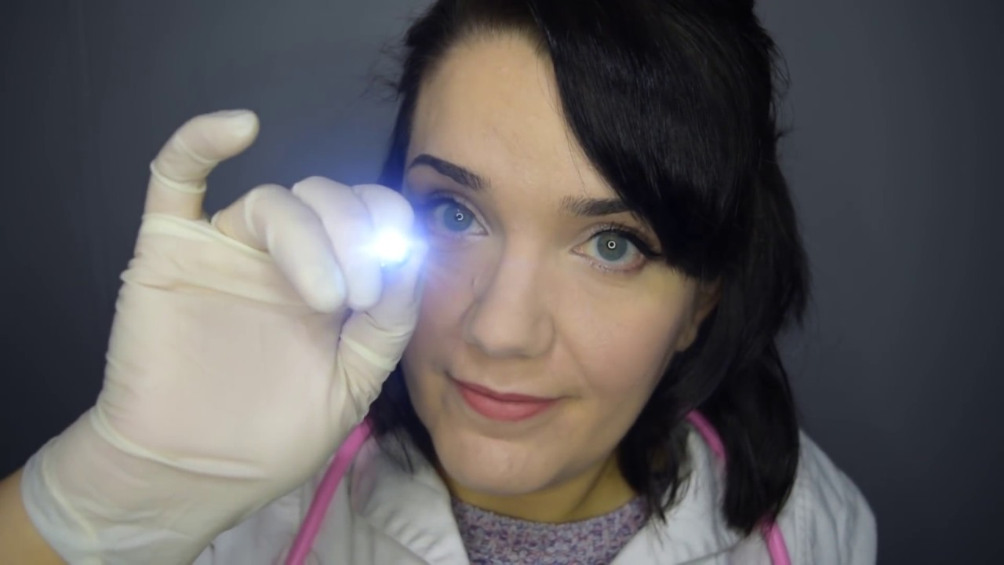
Persona # 3: Nurse
Details
Goals
Lisa has 15 years of experience as a Nurse in Urgent Care facilities. Now during COVID-19, most of the patients complain to her about the waiting period to see the doctor. To help minimize the number of patients in the office Lisa seeks an application to help her patients determine if their skin issues need seeking medical attention immediately.
Lisa wants to refer her patients to a reliable source for skin illnesses that can be treated at home. The SymCheck application would offer guidance to determine what the skin illness may be and give them advice for a home remedy. It would also help stop the spread of COVID-19 by reducing the traffic in Urgent Care facilities. Lisa would use SymCheck to show her patients how reliable it is in diagnosing skin illnesses.

Slide 11

Project Timeline

Slide 12
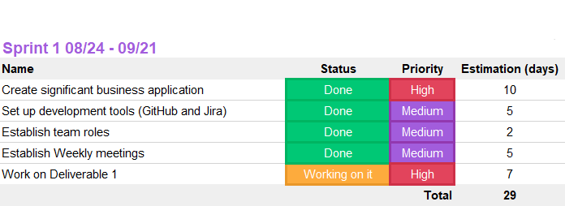
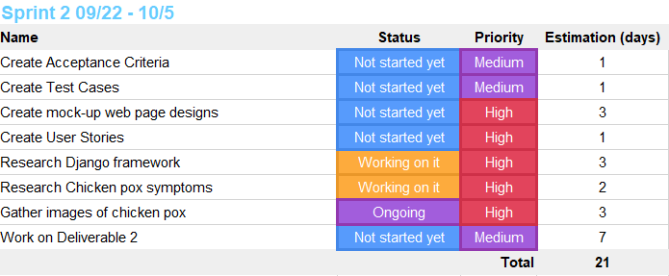
Hidden Agility’s Schedule

Slide 13
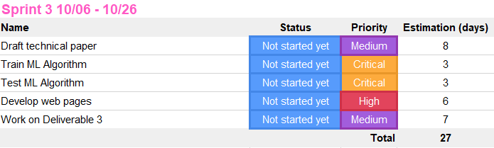
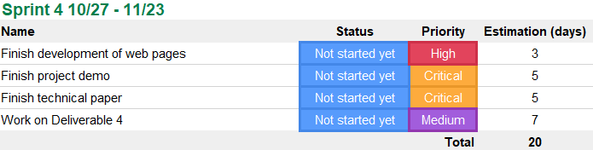
Hidden Agility’s Schedule

Slide 14

Retrospectives

Slide 15
Top voted results
What went well
Keeping a repository of useful material
What needs improvement
Zoom meeting purpose
Next Steps
Define meeting agendas each week
Note taking during meetings

Slide 16

Conclusion GitHub Link https://github.com/jazzymaya/hiddenagility/wiki

